Slide 1
Superstore dataset

Slide 2
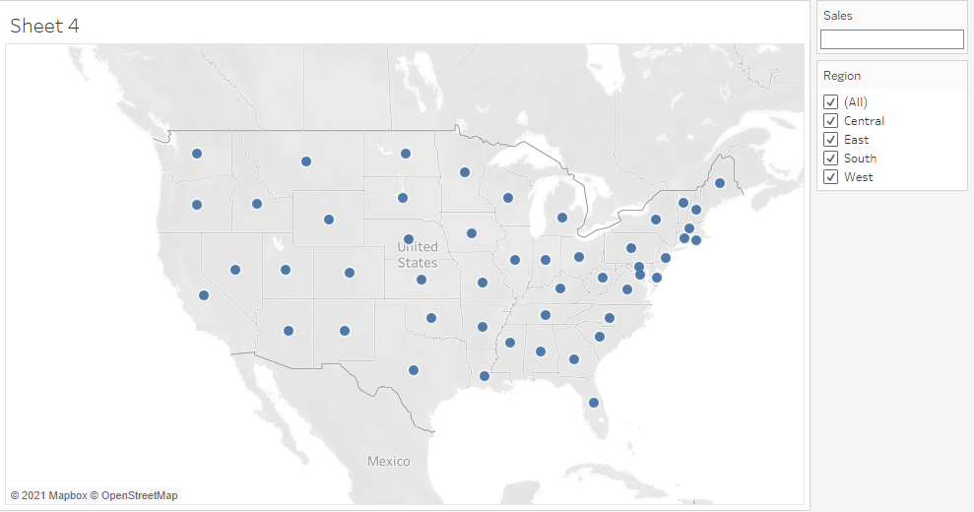
Create a Map view to represent all the states with country

Slide 3
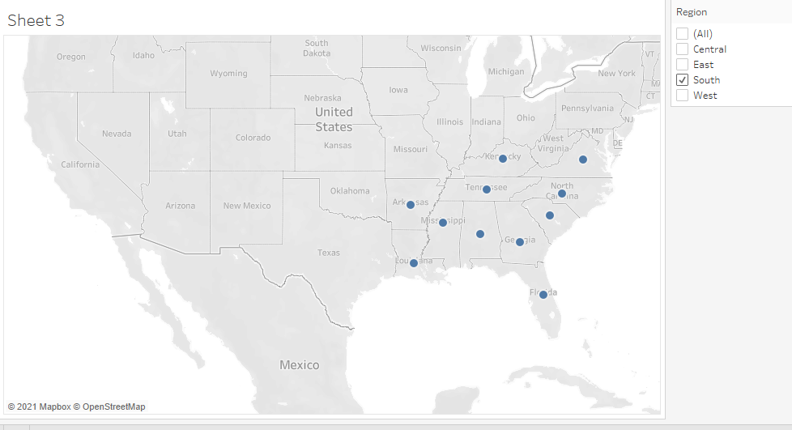
Check your map for south region

Slide 4
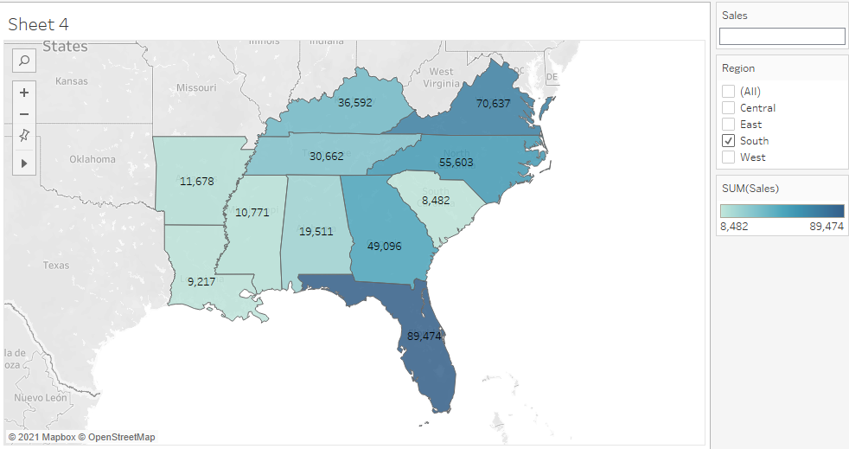
Check the sales for south region

Slide 5
Find the state that has highest sales
Florida

Slide 6
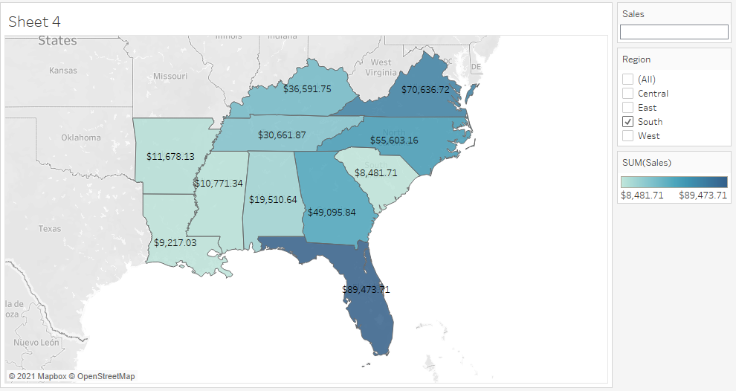
Represent your sales in USD

Slide 7
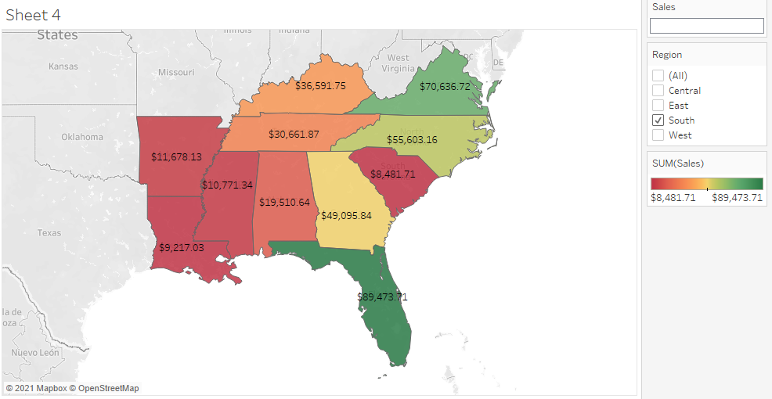
Edit color for you map

Slide 8
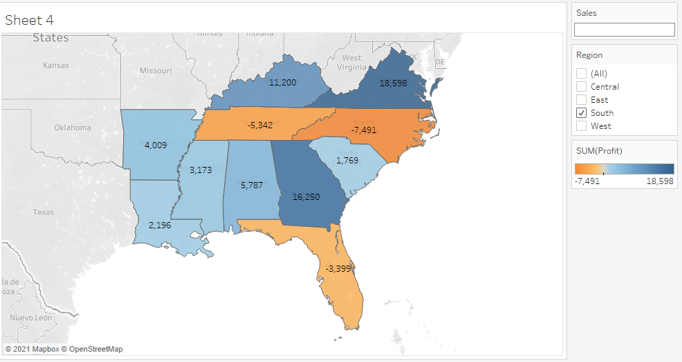
Show profit for all the states in your map in south region.

Slide 9
Find out the name of some states having negative profit
Florida
South carolina
Tennessee

Slide 10
Note down the name of the states having lowest profit and highest profit.
lowest profit - North Caroline
highest profit - Virgina

